Slide 1
Azure – ELB (Elastic Load Balancer)
Vishwanath M S
VISHWACLOUDLAB.ORG

Slide 2
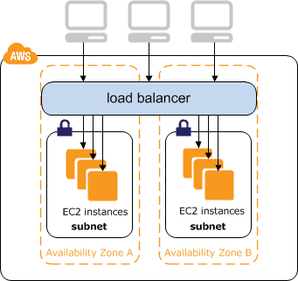
Concepts of ELB (ElasticLoadBalancer)
LoadBalancer is used to share the Load, so that we DON’T have a single point of failure.
AWS LoadBalancer has 2 Parts in it
Create Load Balancers – To configure the Front End
Create Target Groups -- To configure the Back End
A LoadBalancer can also work on IPV6 public IP but only in “Application LB”.
A LoadBalancer is a request Forwarder and does not acknowledge to the request itself to the end users.
A LoadBalancer works WITHIN the VPC.

Slide 3
Concepts of ELB (Elastic LoadBalancer)
Multiple options are
Application Load Balancer
Network Load Balancer
AWS Classic Load Balancer
Application Load Balancer
To perform LB on HTTP and HTTPS
Network Load Balancer
To perform LB on any TCP port
AWS Classic Load Balancer
Previous Generation → HTTP, HTTPS and TCP

Slide 4
Create Load Balancer 4 Sub steps
Sub-Step1: Configure Load Balancer
Sub-Step2: Security Group
Sub-Step3: Configure Routing
Sub-Step4: Register Target

Slide 5
Step1: Load Balancer Configuration Configuration has 2 sub parts
Front End
Whether the LB has to “internet Facing” Or “Internal” facing
The Front-End Public IP is created Automatically for “Application LB”
We have an option to assign a Static Public IP (ElasticIP) for “Network LB”
Back End
For Application LB
We need to add a VPC that has a min of 2 Subnets in 2 Different Availability Zone.
For Network LB
We can have a min of 1 Subnet in the backend.

Slide 6
Step2: Security Group
Since LB is an individual feature, we need to specify what traffic can come in.
This option is available only in “Application LB” and NOT in “Network LB”.

Slide 7
After the Creation of LB
There is an Automatic “DNS” name created by AWS, also called as “A Record” for IPV4 or “AAAA Record” for IPv6.

Slide 8
AutoScaling
It can Scale Out and Scale in
During Scale In, the VM’s are delete in FIFO Manner (First in First Out)

Slide 9
Autoscaling Creation
Launch Configuration
Autoscaling Group

